Slide 1
Regular Expressions

Slide 2
A regular expression is a pattern consisting of a sequence of characters that is matched against the text.
UNIX evaluates text against the pattern to determine if the text and the pattern match.
If they match, the expression is true and a command is executed.
Some of the most powerful UNIX utilities , such as grep and sed, use regular expressions.

Slide 3
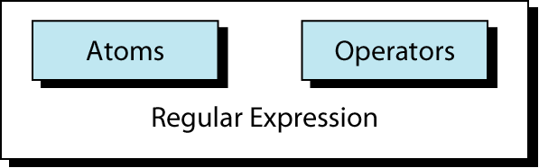
Regular Expression
A regular expression is like a mathematical expression.
A mathematical expression is made of operands (data) and operators.
Regular expression is made of atoms and operators.
The atom specifies what we are looking for and where in the text the match is to be made.
The operator combines atoms into complex expressions.

Slide 4
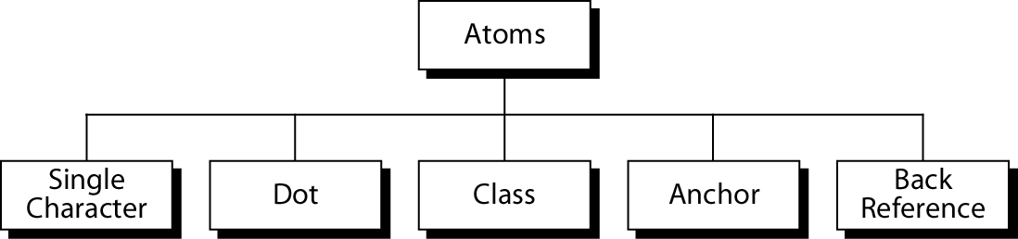
Atoms

Slide 5
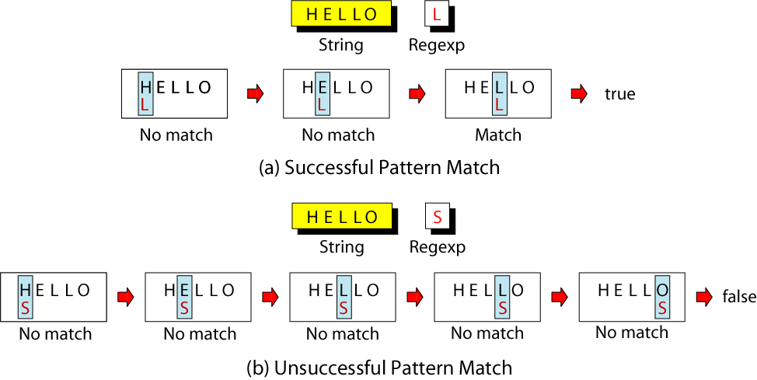
Single-Character Pattern Example
The simplest atom is a single character.

Slide 6
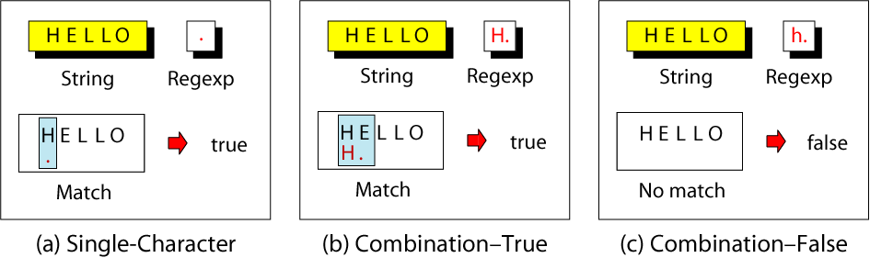
Dot Atom Example
A dot matches any single character except the new line character (\n).

Slide 7
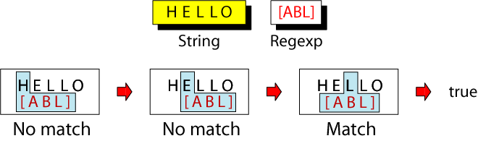
Class Atom Example
The class atom defines a set of ASCII characters, any one of which may match any of the characters in the text.
The character set to be used in the matching process is enclosed in brackets.

Slide 8
3 additional tokens for class operator
  Range
  Exclusion
  Escape character
A range of text characters is indicated by a dash (-). [a-d]
^ is an exclusion operator. To specify any character other than a vowel, we use [^aeiou].
[^ ] indicates complement
The escape character (\) is used when the matching character is one of the other two tokens.

Slide 9
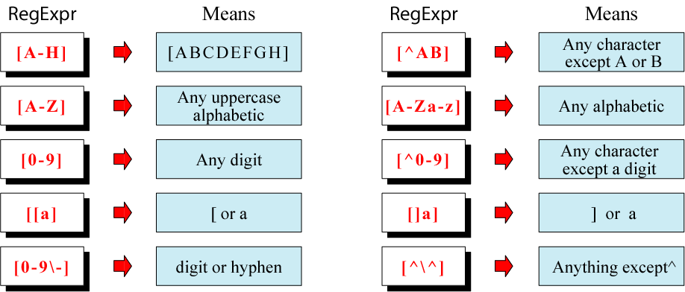
Example of Classes

Slide 10
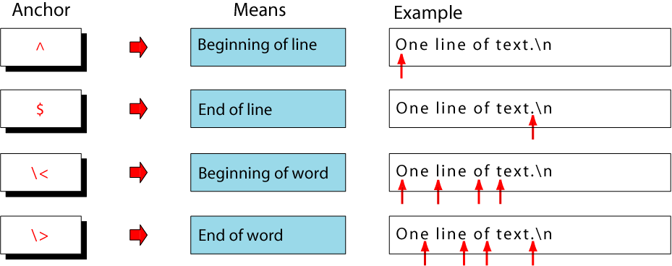
Anchors
Anchors are atoms that are used to line up the pattern with a particular part of a string.
Anchors are not matched to the text, but define where the next character in the pattern must be seen.

Slide 11
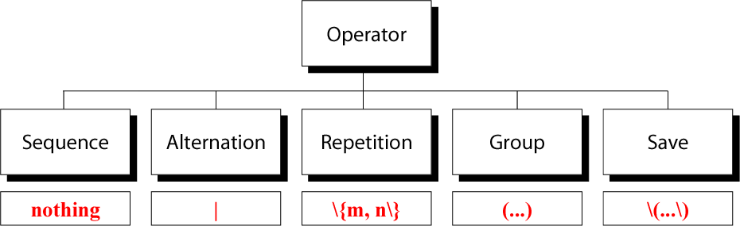
Operators
We can combine atoms with operators.

Slide 12
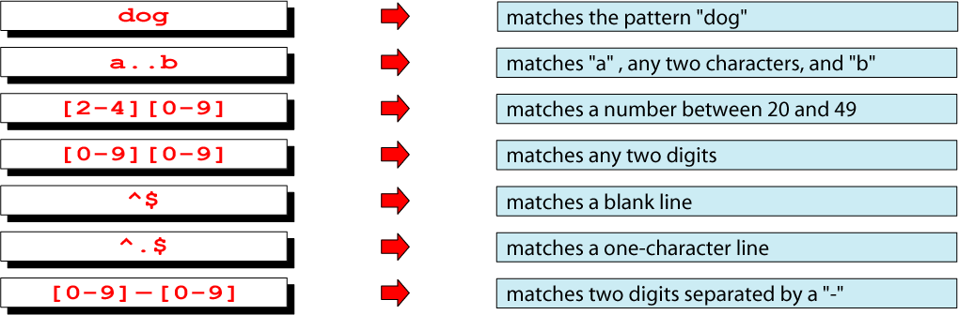
Example of Sequence Operator
The sequence operator is nothing.
This means that if a series of atoms are shown in a regular expression, it is implied that there is an invisible sequence operator between them.

Slide 13
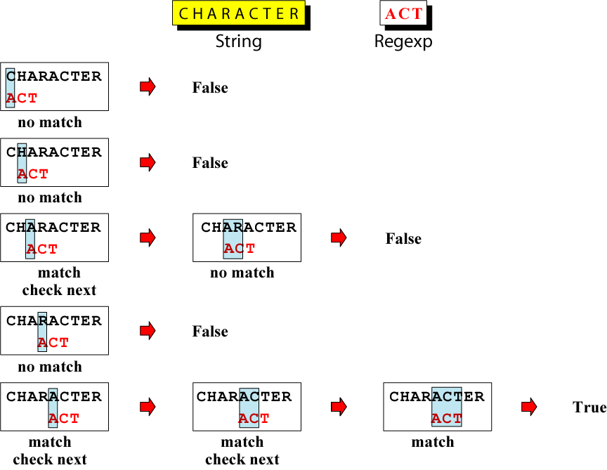
Evaluation of a String
Using Sequence Operator

Slide 14

Alternation Operator
The alternation operator is used to define one or more alternatives.

Slide 15
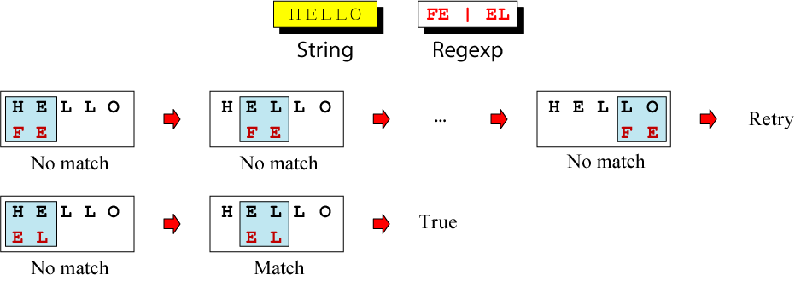
Matching Alternation Operators

Slide 16
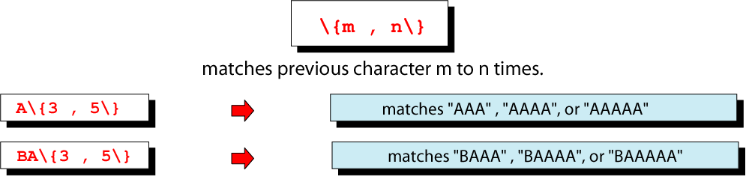
Repetition Operator
The repetition operator specifies that the atom or expression immediately before the repetition may be repeated.
m is a minimum number of repetitions.
n is a maximum number of repetitions.

Slide 17
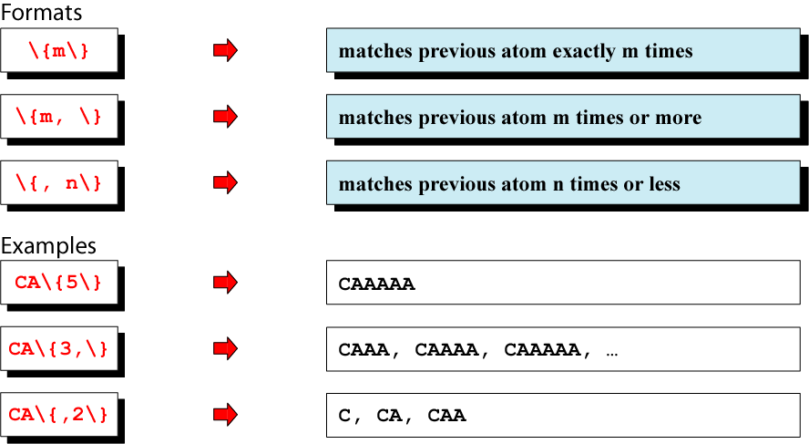
Basic Repetition Forms

Slide 18
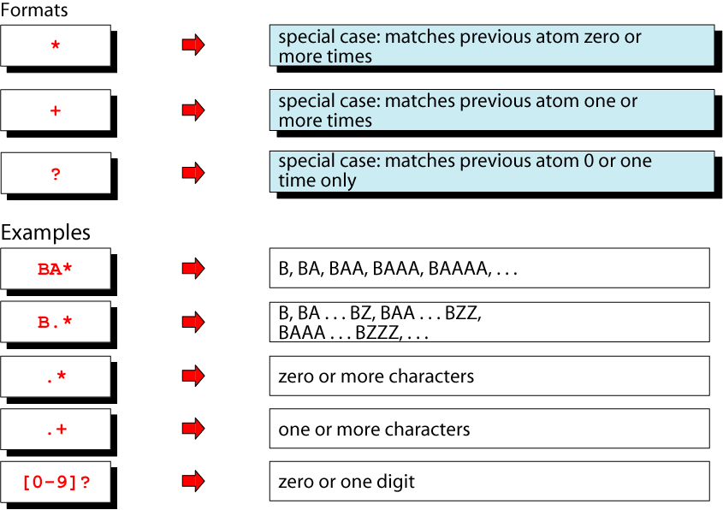
Example of Short Form
Repetition Operators

Slide 19
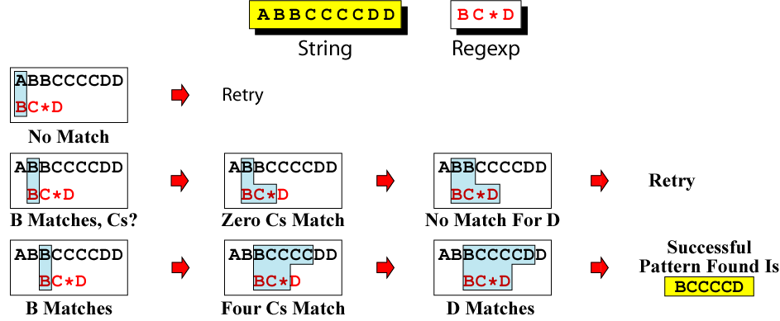
Repeating Pattern Matching

Slide 20
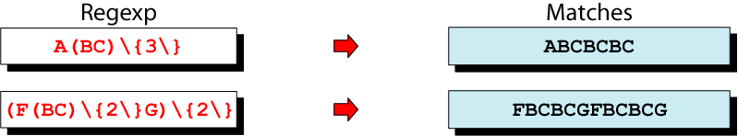
Group Operator
The group operator is a pair of opening and closing parentheses.
When a group of characters is enclosed in parentheses, the next operator applies to the whole group.

Slide 21
Greedy pattern matching
Longest possible string that matches with the pattern
String : ZAYXFOONFOO RE: A.*FOO
(String starting with A and ending with FOO)
Pattern match begins by locating A in second position
It then greedily consumes the rest of the string
Having found the maximum string, it then backs up until it finds a matching FOO
It finds the longest possible matching pattern

Slide 22
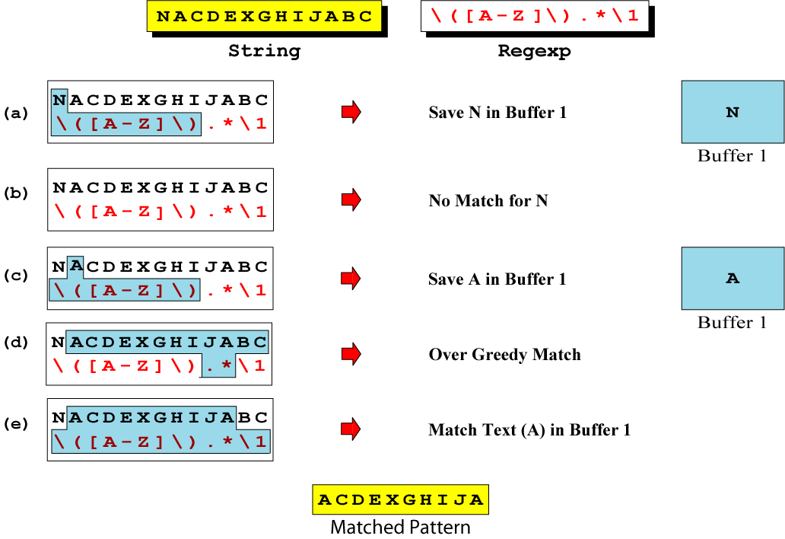
Saving
The save operator copies a matched text string to one of nine buffers for later reference.

Slide 23
Save operator is used with back reference (Ref sed command->back reference)
It starts & ends with \(
    \(…. \)
Eg : swap 2 columns using sed command
sed ‘s/\( .* \) \( .* \)/ \2\1’ filename

